Slide 1

WALMART SALES PROJECT
- Using MYSQL
NITHES KUMAR M

Slide 2
1.INTRODUCTION:
A Walmart sales dataset is a goldmine for data analysts and business intelligence professionals. It offers a vast array of information about consumer behavior, product performance, sales trends, and operational efficiency. By leveraging MySQL's powerful querying capabilities, we can extract valuable insights from this data to inform strategic decision-making.

Slide 3

2.What is a mysql:
MySQL is an open-source relational database management system (RDBMS) developed by Oracle Corporation.
It uses Structured Query Language (SQL) for database management and is known for its reliability, speed and ease of use.
MySQL is widely used for various applications, from small websites to large-scale enterprise systems.

Slide 4
3. Project Objectives:
Sales Analysis:
Identifying top-selling products and categories
Analyzing sales trends over time
Measuring the impact of holidays and promotions on sales
Comparing sales performance across different stores
Customer Behavior:
Understanding customer demographics and preferences
Analyzing customer purchasing patterns
Identifying customer segmentation based on buying behavior
Store Performance:
Evaluating store-level sales performance
Identifying factors influencing store sales (e.g., location, size, competition)
Optimizing store inventory and staffing levels

Slide 5
4. Benefits of Using MySQL:
Scalability: It can handle large datasets efficiently.
Speed: It performs queries quickly, allowing for real-time analysis.
Cost-effectiveness: It's open-source and free to use.
Reliability: It has a proven track record of handling critical business data
Flexibility: It supports various data types and complex queries.

Slide 6

MYSQL DATABASE:

Slide 7
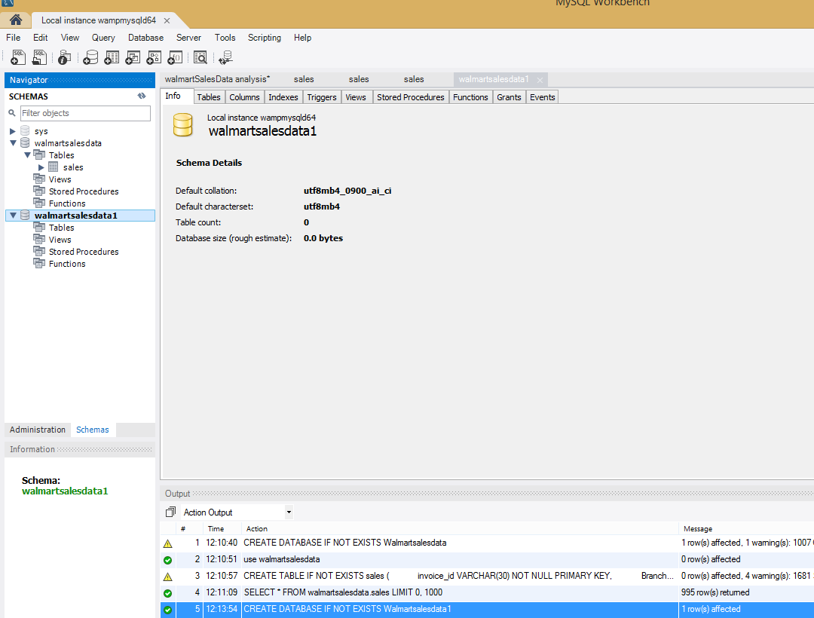
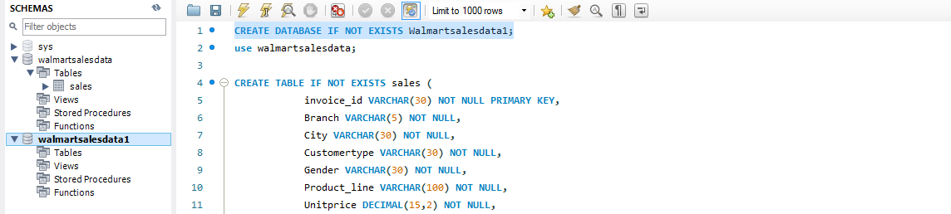
1.CREATE A DATABASE:

Slide 8
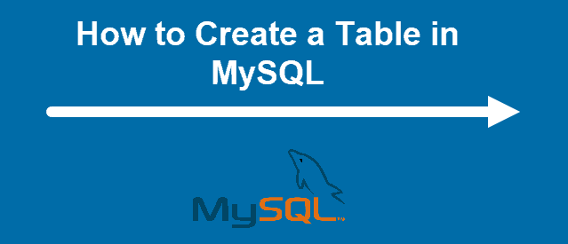
CREATE A TABLES:

Slide 9
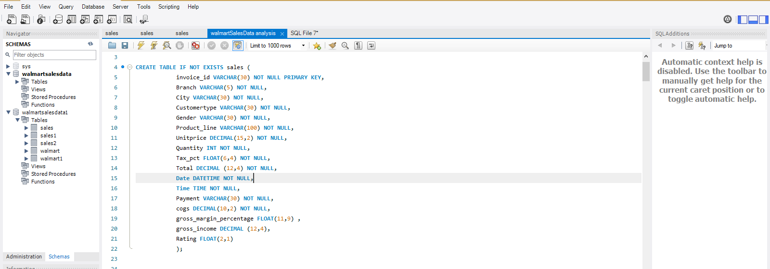
1.CREATE A TABLE:

Slide 10
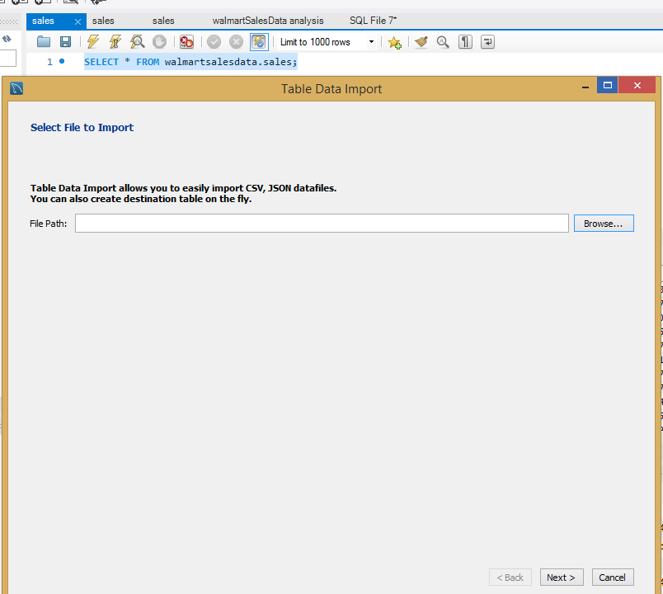
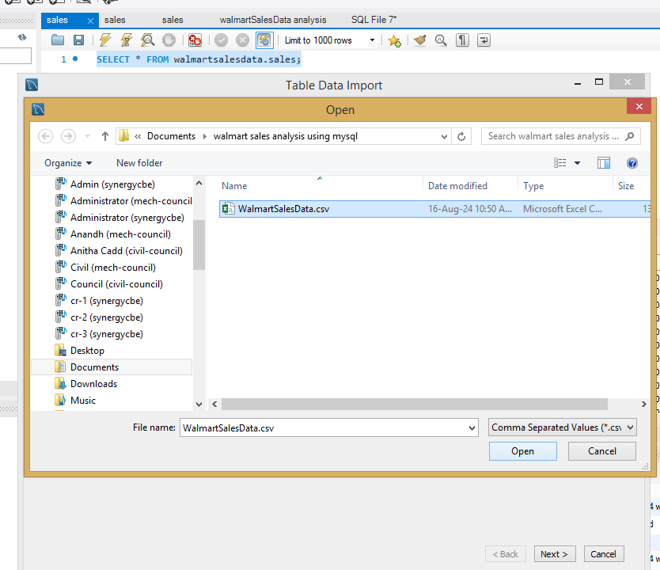
2. csv file data import a database :
STEP1:
STEP2:

Slide 11
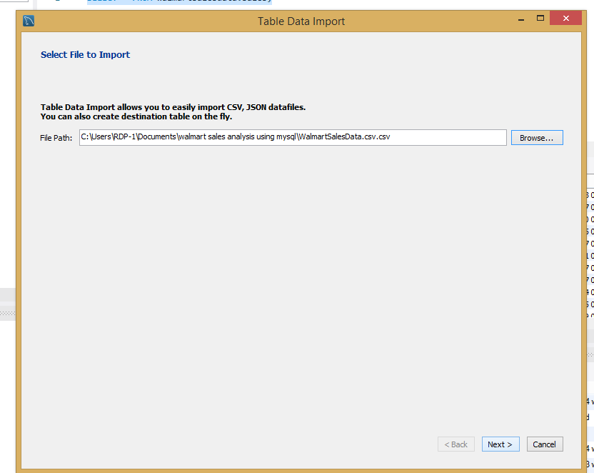
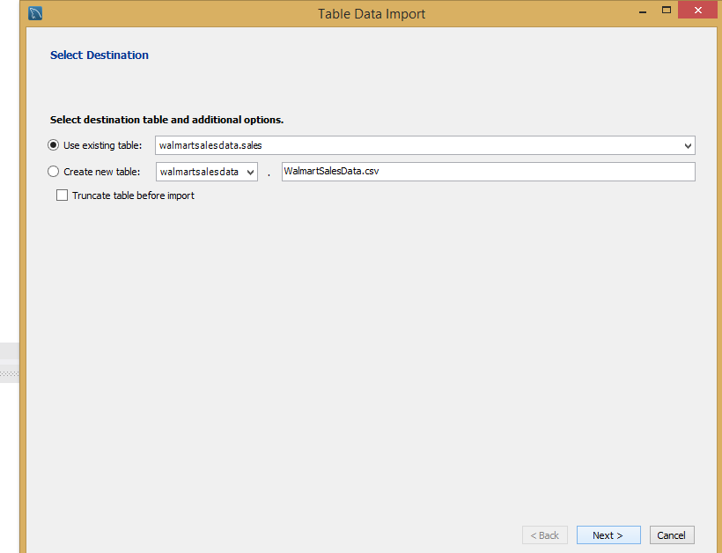
csv file data import a database :
STEP3:
STEP4:

Slide 12
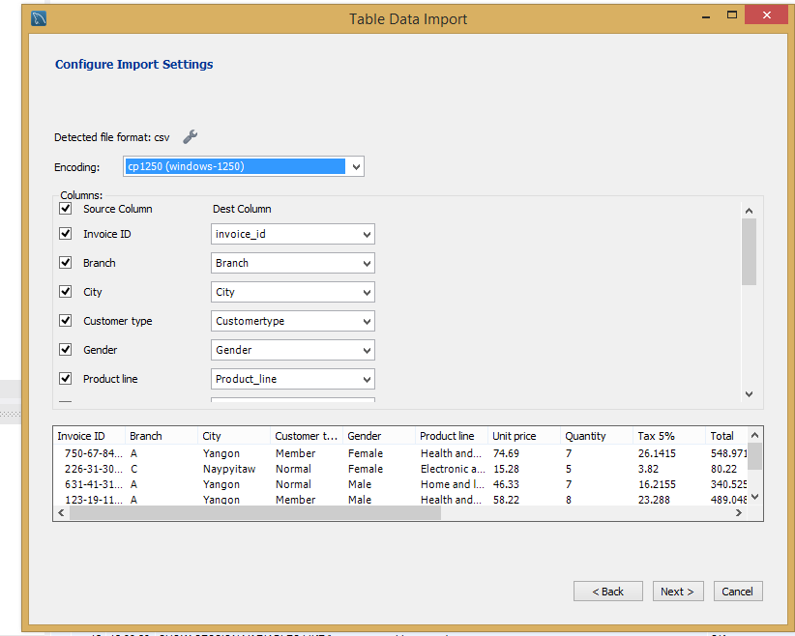
csv file data import a database :
STEP5:

Slide 13
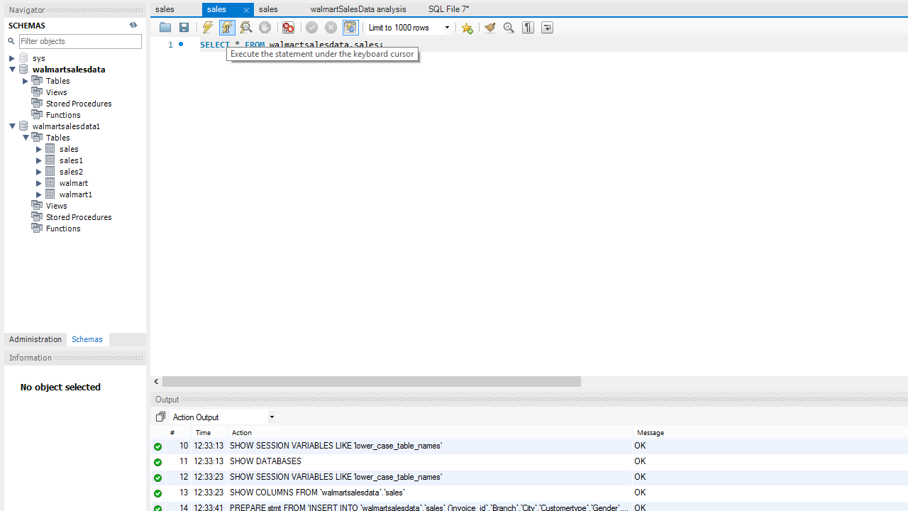
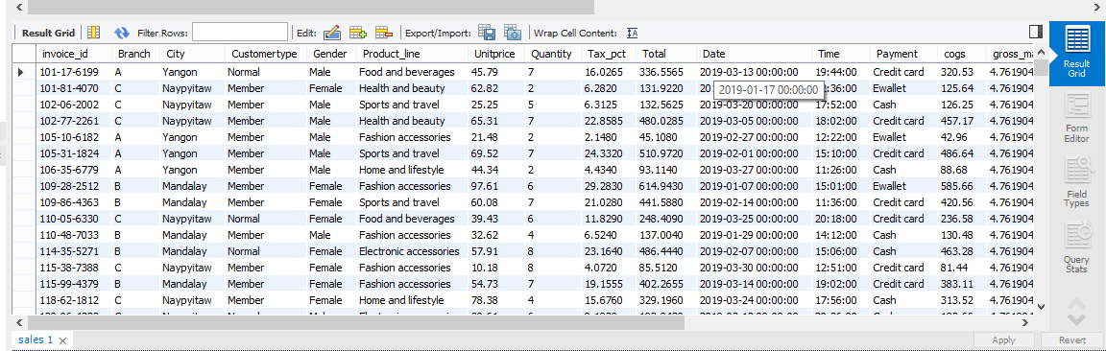
3. SHOW A DATABASE:
OUTPUT:

Slide 14

DATA CLEANING AND ADD DATA:

Slide 15
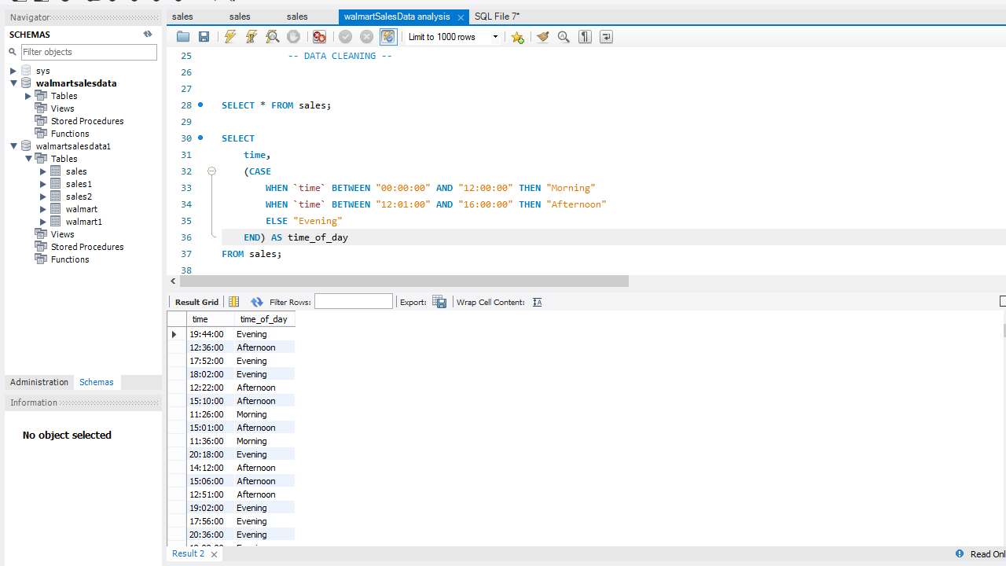
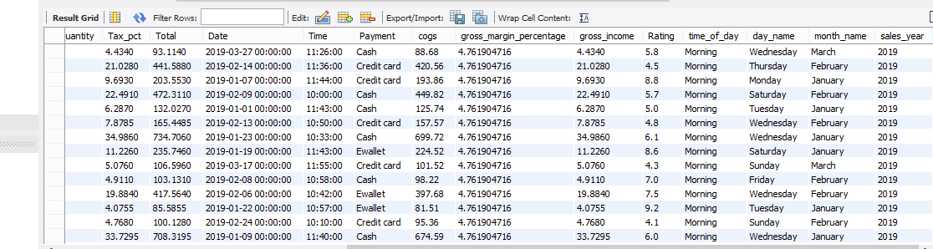
1.Data cleaning add a data table:
ADD TIME_OF_DAY:
OUTPUT:

Slide 16
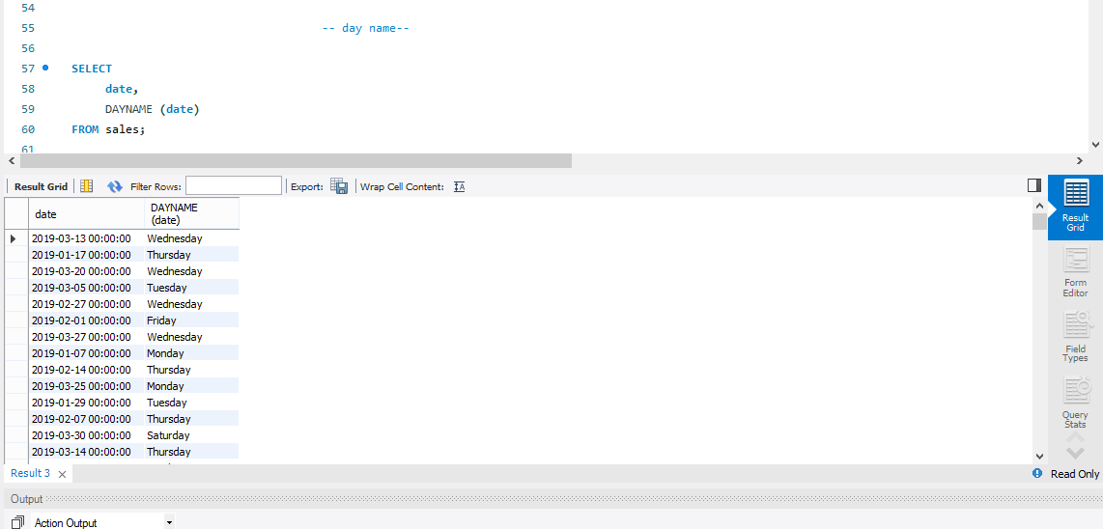
Data cleaning add a data table:
ADD DAY NAME:
OUTPUT:

Slide 17
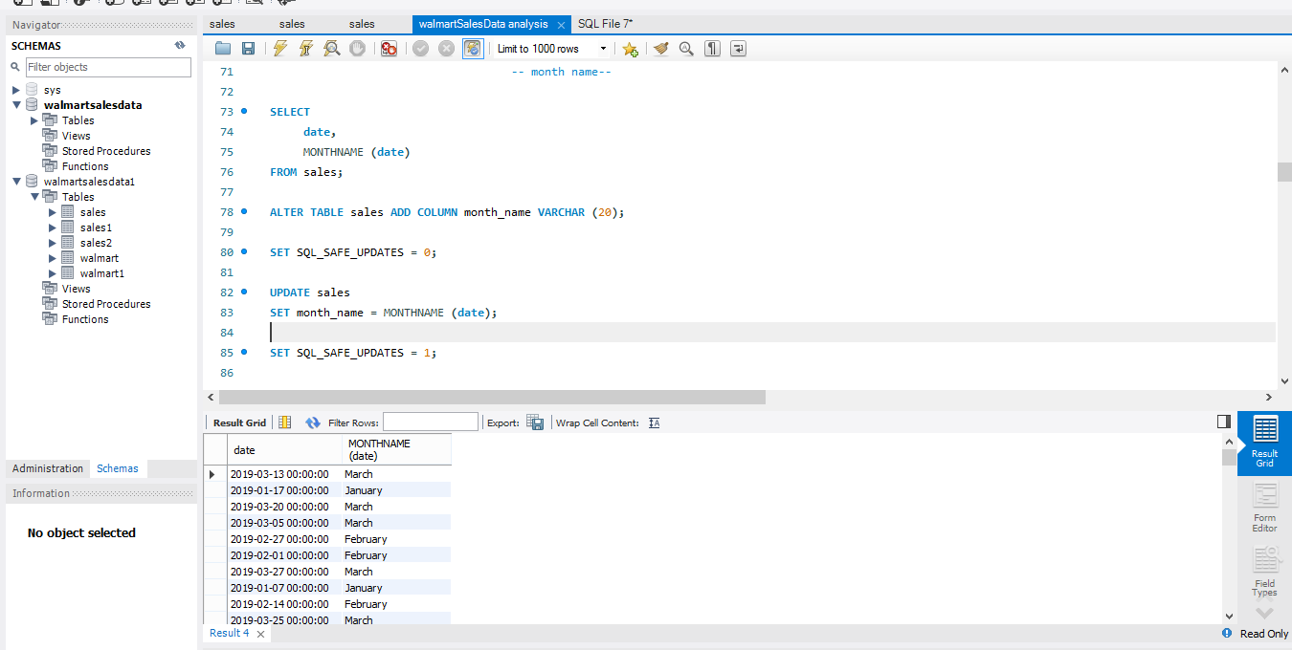
Data cleaning add a data table:
ADD MONTH NAME:
OUTPUT:

Slide 18
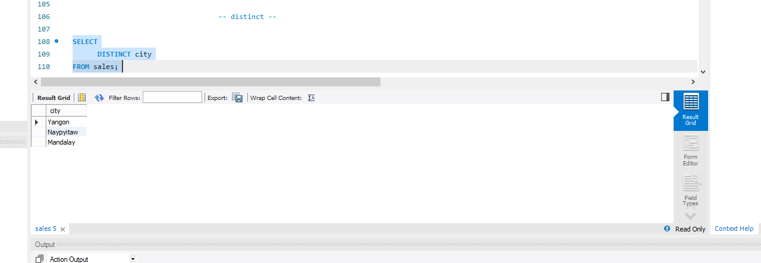
2.distinct

Slide 19
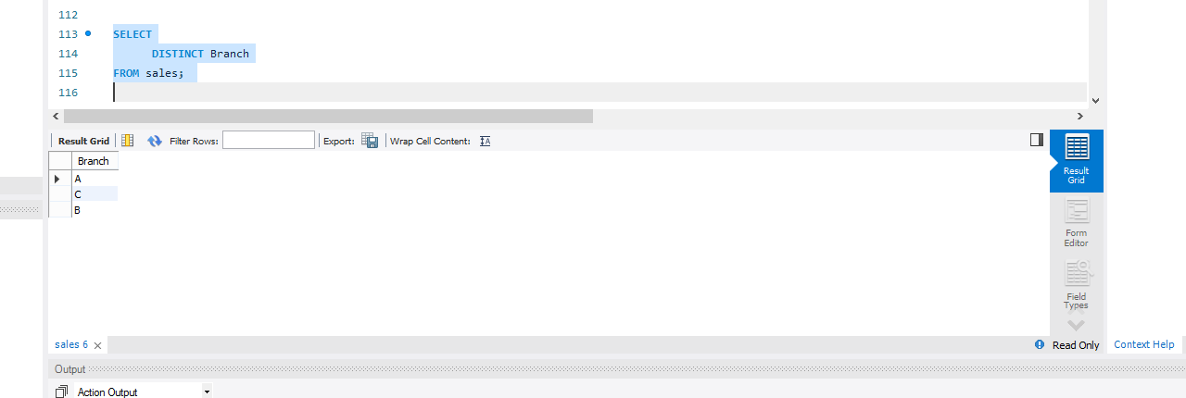
distinct

Slide 20
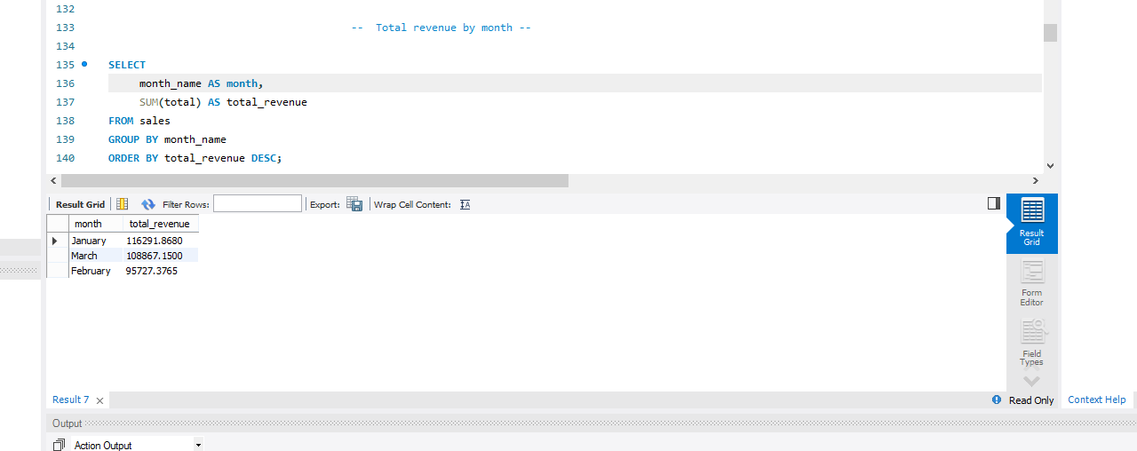
3.Total revenue by month

Slide 21
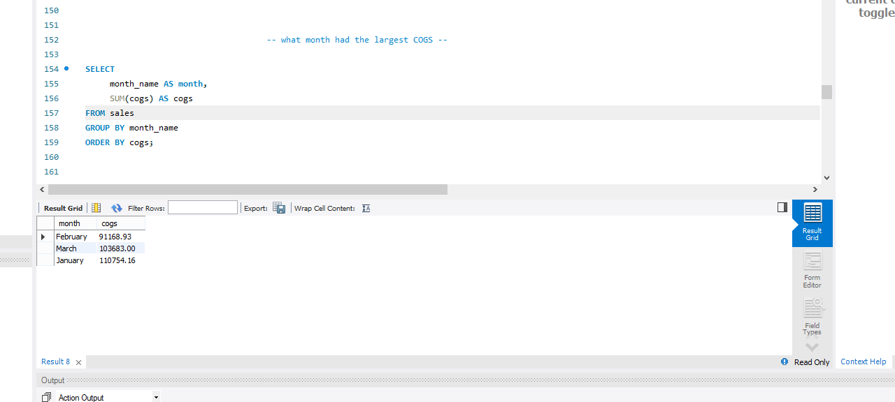
4.what month had the largest COGS

Slide 22
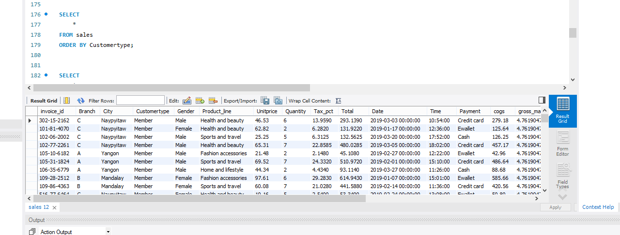
5. ORDER BY

Slide 23

THE CUSTOMERS SEGMENT:

Slide 24
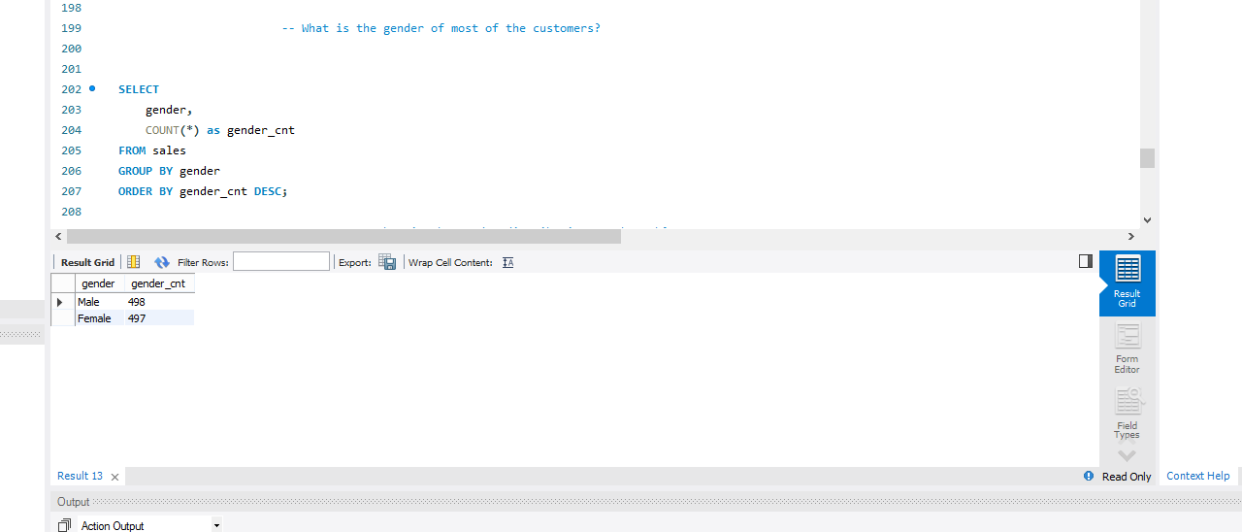
1. What is the gender of most of the customers?

Slide 25
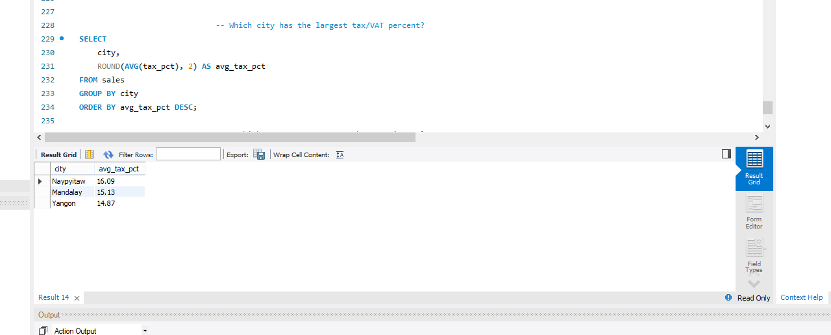
2. Which city has the largest tax/VAT percent?

Slide 26
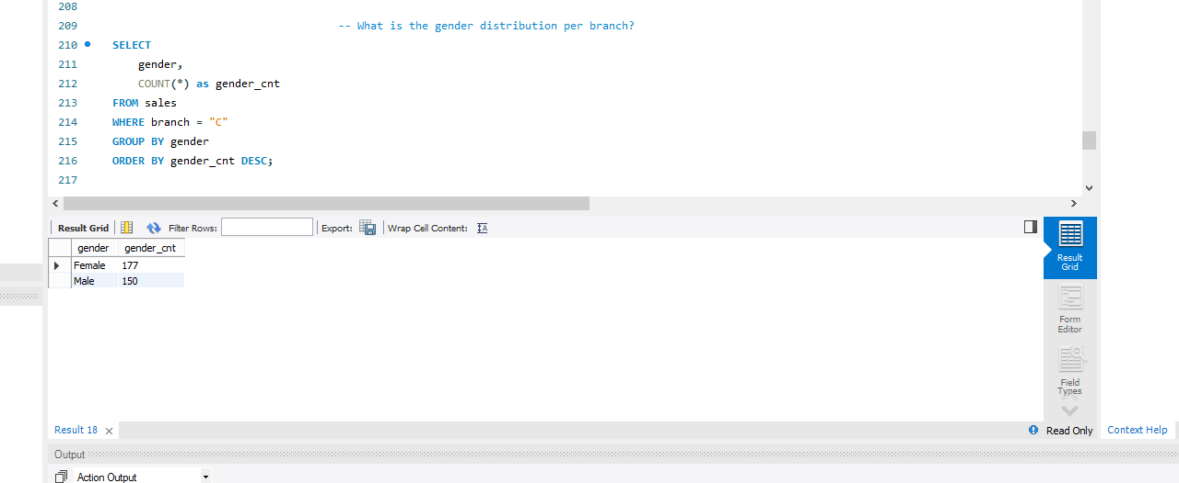
3. What is the gender distribution per branch?

